Slide 1

ABC CALL VOLUME TREND ANALYSIS
A PROJECT BY DEBARATI CHATTERJEE

Slide 2
PROJECT DESCRIPTION
A customer experience (CX) team consists of professionals who analyse customer feedback and data, and share insights with the rest of the organization. Typically, these teams fulfil various roles and responsibilities such as: Customer experience programs (CX programs), Digital customer experience, Design and processes, Internal communications, Voice of the customer (VoC), User experiences, Customer experience management, Journey mapping, Nurturing customer interactions, Customer success, Customer support, Handling customer data, Learning about the customer journey.
In a Customer Experience team there is a huge employment opportunities for Customer service representatives A.k.a. call centre agents, customer service agents. Some of the roles for them include: Email support, Inbound support, Outbound support, social media support.
Inbound customer support is defined as the call centre which is responsible for handling inbound calls of customers. Inbound calls are the incoming voice calls of the existing customers or prospective customers for business which are attended by customer care representatives. Inbound customer service is the methodology of attracting, engaging, and delighting customers to turn them into my business' loyal advocates. By solving customers' problems and helping them achieve success using company’s product or service, company can delight their customers and turn them into a growth engine for business.

Slide 3
APPROACH
I spent some time familiarizing myself with the data before commencing the analysis. Examine the data structure to obtain a feel of the overall content. This allows me to identify any potential concerns or obstacles that I may encounter while I do my analysis.
I check for any null values or missing data in the dataset, and examine if removing blank cell would effect data analysis.
When I finish my data analysis, I present my insights to the audience in a clear and concise manner. I use advance excel concept such as pivoting, conditional formatting and utilize visuals like charts and graphs to help me express my findings.
I used Mathematical formula to find out solution for given problems.
Link of Excel Work Book File :
https://docs.google.com/spreadsheets/d/1-gOO6g0zu1YG8mIzHH-Q5qi9YeDCOH6u/edit?usp=sharing&ouid=110345419604987102522&rtpof=true&sd=true

Slide 4



TECH-STACKED USED
Microsoft Excel
Microsoft PowerPoint
Loom
To analysis and summarise given dataset, visualize with appropriate graphs and find valuable insights
To present the report in structured manner.
To record the video presentation

Slide 5
DATASET DESCRIPTION
For final project a dataset of a Customer Experience (CX) Inbound calling team for 23 days is provided. Data includes
Agent_Name
Agent_ID
Customer_Phone_No
Queue_Time [duration for which customer have to wait before they get connected to an agent]
Date_&_Time
Time [time at which call was made by customer in a day]
Time_Bucket [for easiness we have also provided you with the time bucket]
Duration [duration for which a customer and executives are on call ]
Call_Seconds [for simplicity we have also converted those time into seconds]
call status (Abandon, answered,transferred).
The table has 117988 entries of phone calls.

Slide 6

PROBLEM STATEMENT
We propose few problem statement to find solution
Calculate the average call time duration for all incoming calls received by agents (in each Time_Bucket).
Show the total volume/ number of calls coming in via charts/ graphs [Number of calls v/s Time]. You can select time in a bucket form (i.e. 1-2, 2-3, …..)
As you can see current abandon rate is approximately 30%. Propose a manpower plan required during each time bucket [between 9am to 9pm] to reduce the abandon rate to 10%. (i.e. You have to calculate minimum number of agents required in each time bucket so that at least 90 calls should be answered out of 100.)
d. Let’s say customers also call this ABC insurance company in night but didn’t get answer as there are no agents to answer, this creates a bad customer experience for this Insurance company. Suppose every 100 calls that customer made during 9 Am to 9 Pm, customer also made 30 calls in night between interval [9 Pm to 9 Am] and distribution of those 30 calls are as follows:
Now propose a manpower plan required during each time bucket in a day. Maximum Abandon rate assumption would be same 10%.

Slide 7
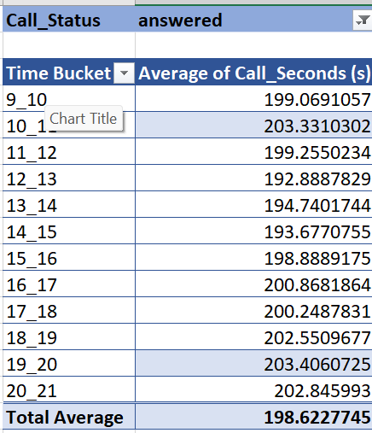
AVERAGE CALL SECOND PER TIME BUCKET
INSIGHT:
Average call seconds duration in incoming calls received by an Agent is 198.62 second, 19-20 time bucket has maximum average call duration

Slide 8
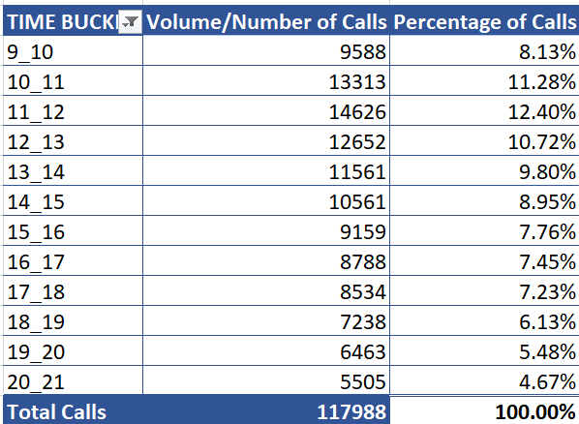
CALL VOLUME TREND PER TIME BUCKET
INSIGHT:
Total 117988 calls came between 1 Jan 22 to 23 Jan 22, among all time bucket 11-12 had highest number of incoming calls which is 12.40% of total phone calls

Slide 9
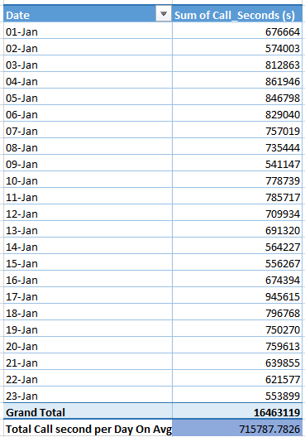
CALL STATUS ANALYSIS
Assumption: An agent work for 6 days a week; On an average total unplanned leaves per agent is 4 days a month; An agent total working hrs is 9 Hrs out of which 1.5 Hrs goes into lunch and snacks in the office. On average an agent occupied for 60% of his total actual working Hrs (i.e 60% of 7.5 Hrs) on call with customers/ users. Total days in a month is 30 days
On average 70% incoming call answered
Employee’s working hour= 7.5 hours
Employee’s working hour on call =
60% of 7.5 hour = 4.5 hour
Average no of incoming calls per day =
Total calls /23 = 117988 / 23 = 5130

Slide 10
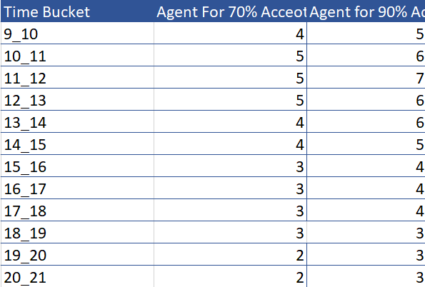
AGENT DISTRIBUTION PER TIME BUCKET IN DAY
On average total call seconds per day=715787.7826 s
On average total call hours per day = 715787.7826/3600=198.8299396 hour
Agent required for 70% accepted calls = 198.8299396 hours /4.5 hours = 44 (approximately)
Agent required for 90% accepted calls = 44*9/7=57 (approximately)
We can distribute 57 agents on different time bucket for requirement.
11-12 time slot has high demand so we can allocate 7 agents while 18-21 time slot is low demand so we can allocate 3 agents per hour.
Formula used : Agent for 90% accept call =
% of call per time bucket * 57

Slide 11
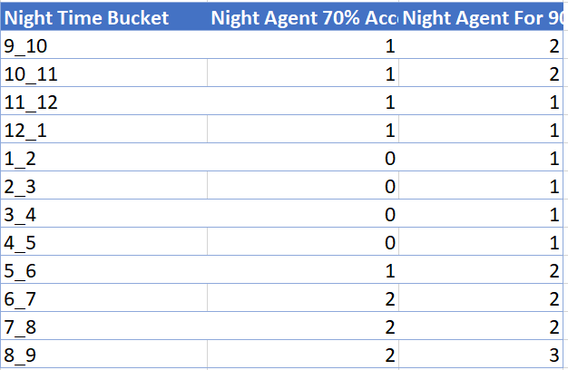
AGENT DISTRIBUTION PER TIME BUCKET IN NIGHT
Average call at night = 30% of average call at day = 30% 0f 5130 = 1539
Average call seconds = 139.5321473
Total call second at night = 139.5321473 * 1539 = 214739.9747 s
Total call hour at night = = 214739.9747/3600 = 59.64999297 hr.
Agent required for 70% call acceptance at night = 59.64999297/4.5 = 13
Agent required for 90% call acceptance at night = 13* 9/7 = 17
We can distribute 17 agents on different time bucket for requirement.
8-9 time slot has high demand so we can allocate 3 agents while 1-5 time slot is low demand so we can allocate 1 agents per hour.
Formula used : Agent for 90% accept call =
% of call per time bucket * 17

Slide 12
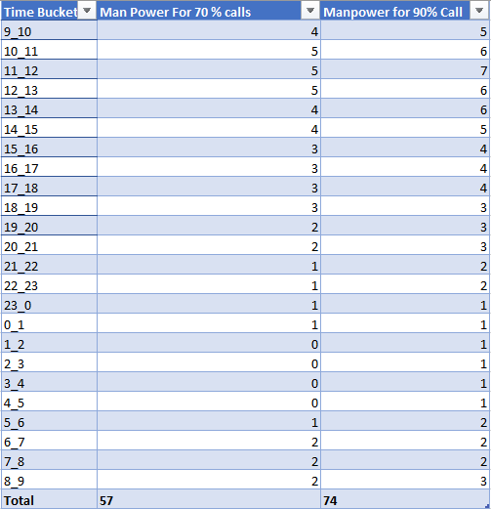
MAN POWER MANAGEMENT
Total Agent present at the call center = 65
Each agent work for 6 days in week with 4 unplanned leaves in month .
Total working day for each agent = 24 -4 = 20 day.
Total Man power needed in 30 days for 10% abandon call rate = 74*30 = 2220
Total man power present = 65* 20=1300
Man Power required = 2220-1300=920
Agent recruitment needed = 920/20 = 46
Total Agent requires for 10% abandon call rate throughout the day for each day = 57+17=74

Slide 13

INSIGHT
Average call seconds duration in incoming calls received by an Agent is 198.62 second, 19-20 time bucket has maximum average call duration 203.4 s followed by 10-11 time bucket with 203.3s average call duration.
Total 117988 calls came between 1 Jan 22 to 23 Jan 22, among all time bucket 11-12 had highest number of incoming calls which is 12.40% of total phone calls
Average incoming call per day is 5130 and 70% call are answered on average.
For 90% call acceptance rate 57 agents required per day on average and 17 agents requires per night on average.
For 10 % abandon call rate each day throughout the month the company needs 46 more agents.

Slide 14
CONCLUDION
This project has helped gain experience on working with real life data set.
I get the opportunity to explore Microsoft Excel in a larger level which helped me to level up my Excel skill.
I learnt mathematical analysis to find deeper insight from any dataset.
Further this project gives me an insight of call centre company and how incoming calls are handled. It also helped me to understand how we can manage man power in a company for best possible outcomes.

Slide 15

THANK YOU
THANK YOU

